Slide 1

Data-Driven Workflow for Predicting Stock Trends in Dating App Companies
Scottie
20241007

Slide 2
Motivation
Data Source
Flow chart
4. Method
5. Result
6. Conclusion
IDA Template

Slide 3
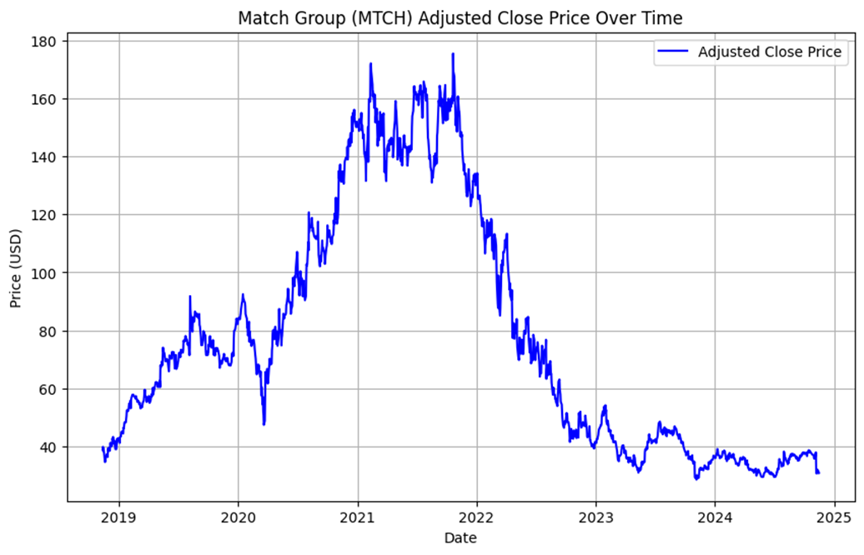
Motivation
Motivation
Dynamic Market Changes : The stock price of online dating companies has experienced significant fluctuations over the years From 2019 to 2021, prices surged to a peak of over $160, followed by a sharp decline to below $40 by 2023.
IDA Template
Notes:
this chart shows reflecting rapid and dramatic changes.

Slide 4
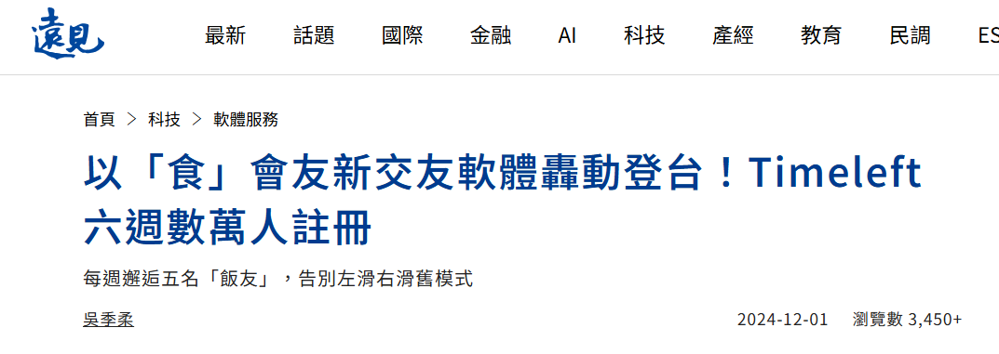

Motivation
Motivation
Impact of External Factors :
Events like the COVID-19 pandemic significantly impacted platform usage and, consequently, stock prices, amplifying the market’s unpredictability. Risk Management through Liquidity
The rise of Meta's Threads and the emergence of unconventional dating platforms (e.g., friend-finding or interest-based apps) provide further diversified user preferences, creating new competition and influencing market dynamics.
threads
Goal: Develop a short-term backtesting framework to evaluate trading strategies based on stock trend predictions
IDA Template

Slide 5
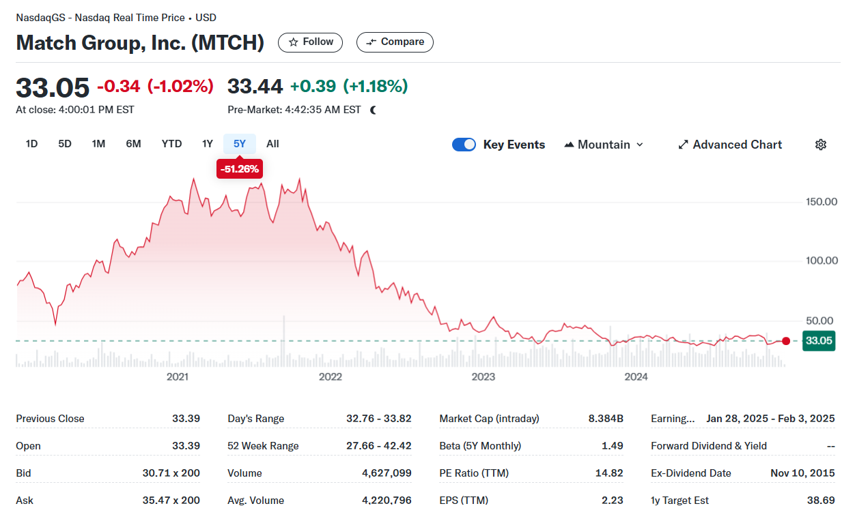
Data (https://finance.yahoo.com/quote/MTCH/)
Key Features
High, low, open, and close prices, trade volume
Technical indicators
Moving Averages (SMA_10 and SMA_30)
Relative Strength Index (RSI_14)
Bollinger Bands
Moving Average Convergence Divergence (MACD)
IDA Template

Slide 6
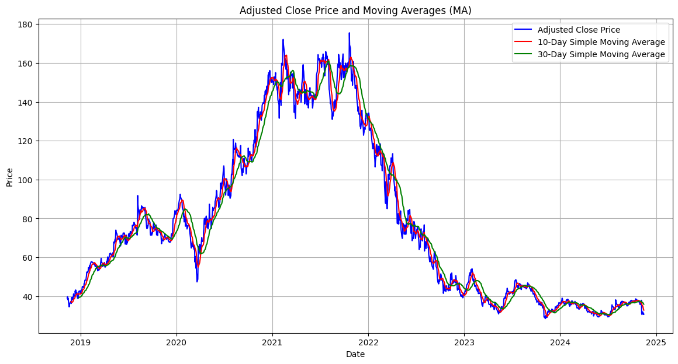
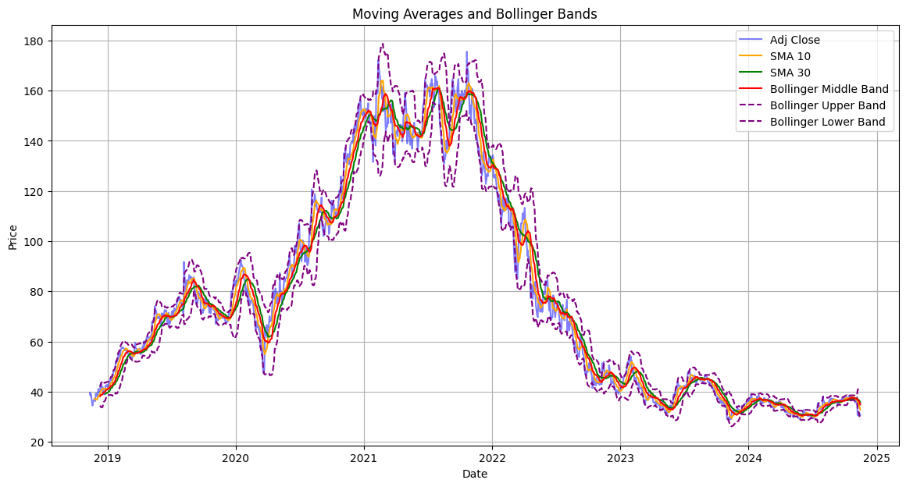
MA
Bollinger Bands
IDA Template

Slide 7
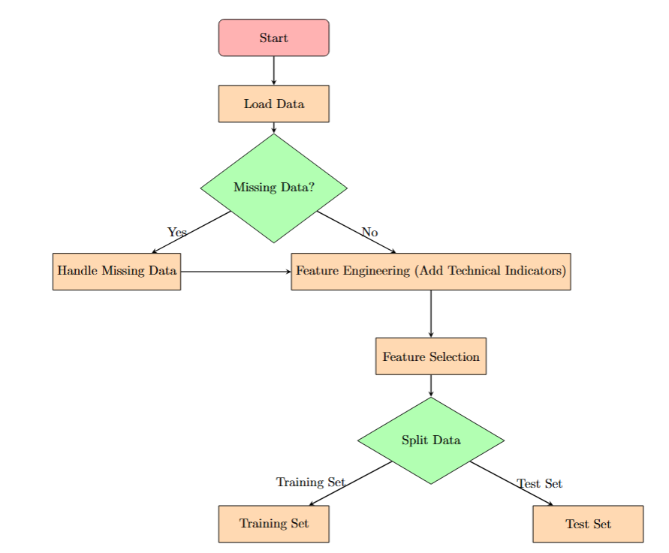
Flow chart
IDA Template

Slide 8
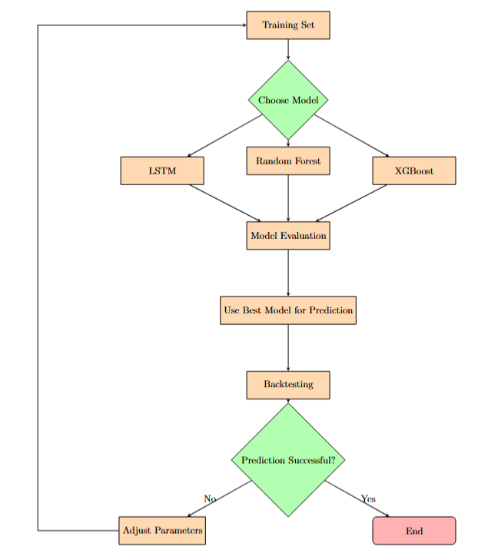
Flow chart
IDA Template

Slide 9
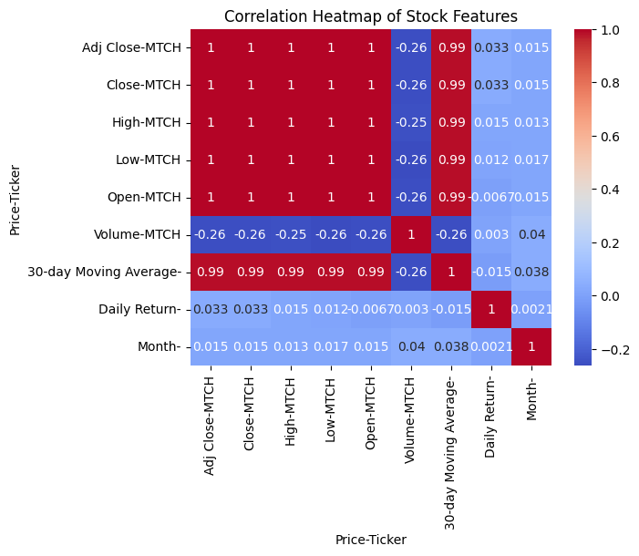
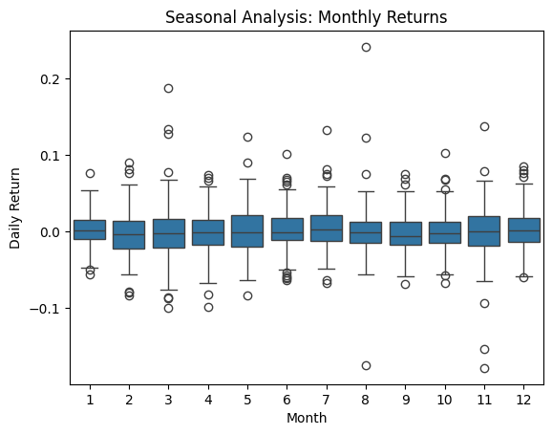
Data
Exploratory Data Analysis
Seasonal Analysis: Monthly Returns
Correlation heatmap
IDA Template

Slide 10
Data
Data Pre-process & Feature Engineering
Handling Missing Values: Removed NaN values generated during technical indicator calculations.
Derived technical indicators from raw data
Simple Moving Averages (SMA)
Short-term (10-day): SMA_10
Long-term (30-day): SMA_30
Relative Strength Index (RSI): Assesses the strength of price movements.
IDA Template

Slide 11
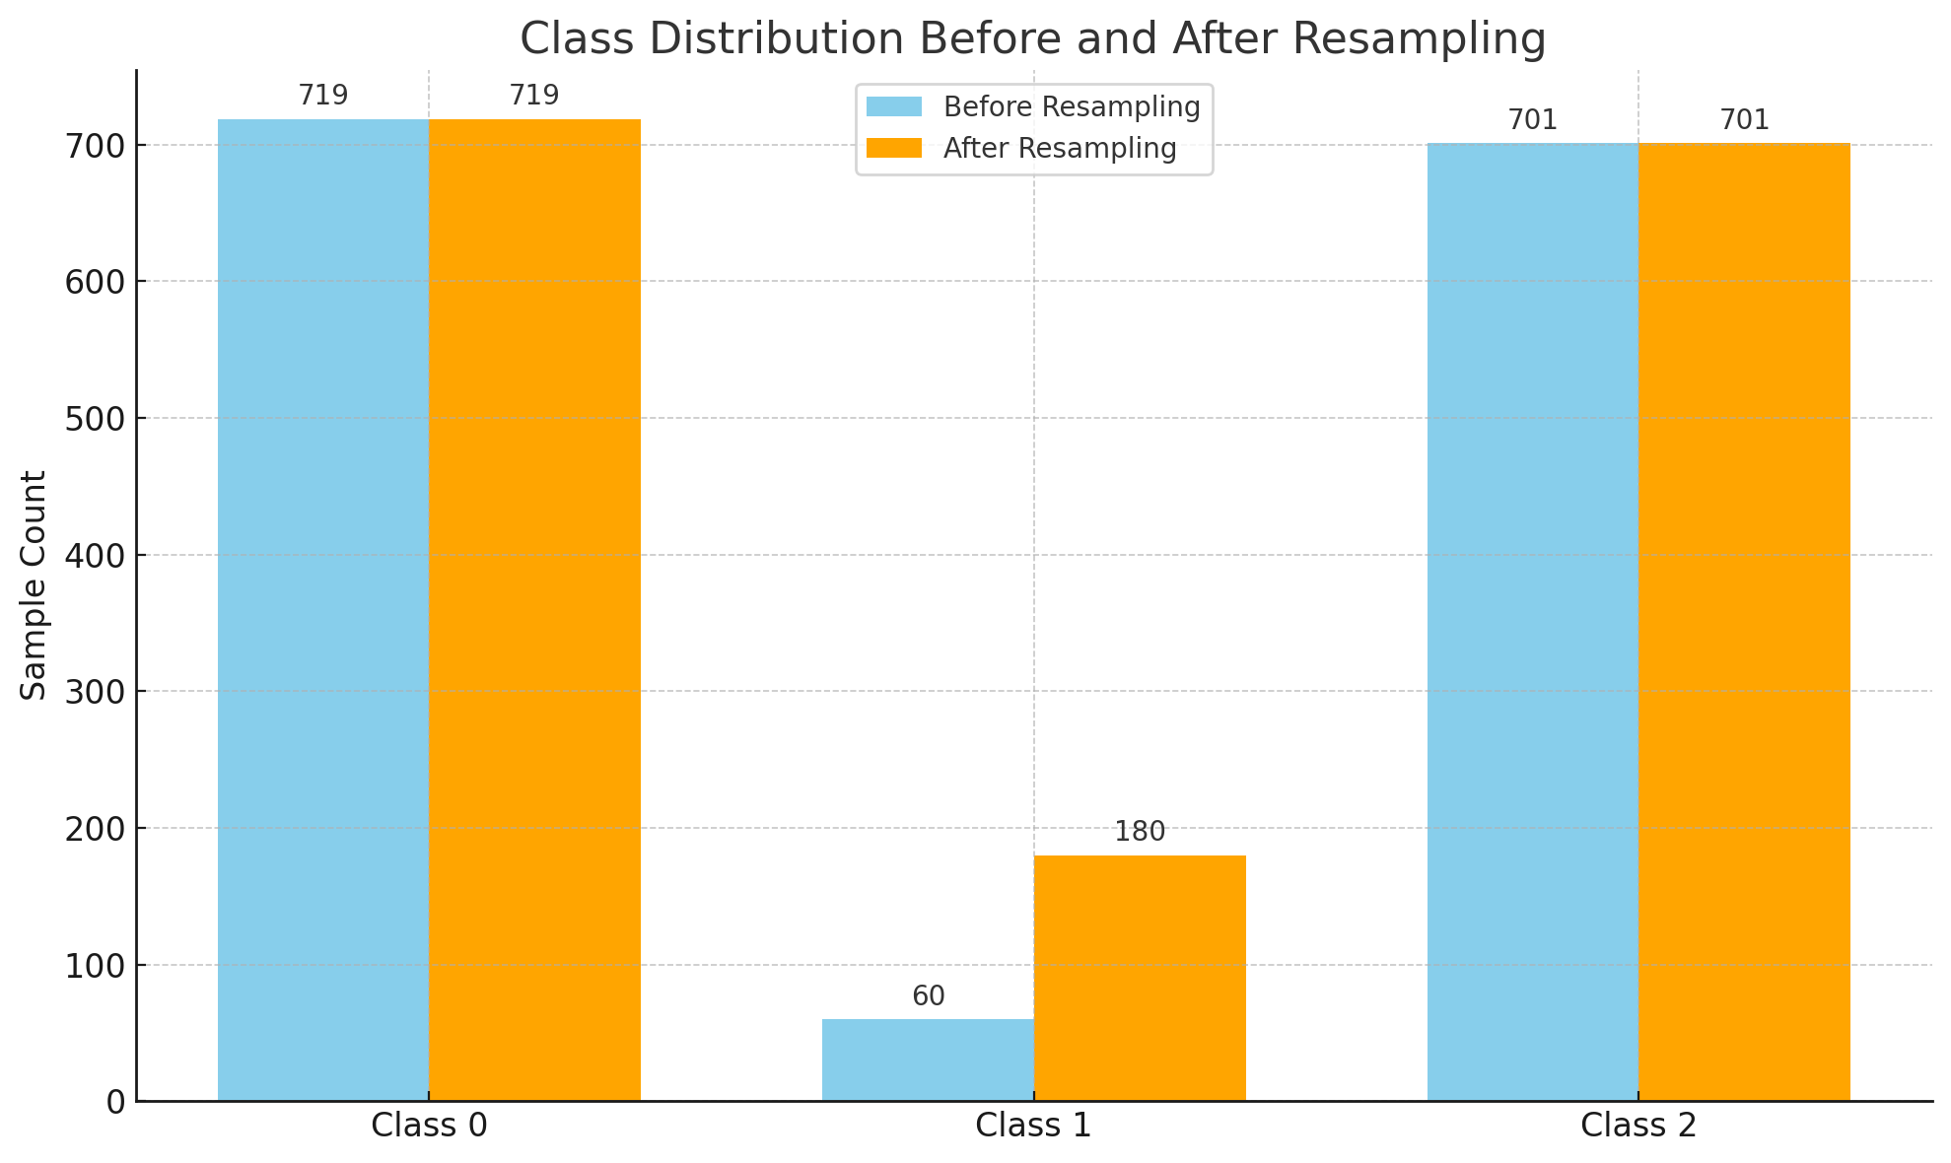
Feature Engerineering
Label creation for predicting short-term trends: Up (U), Down (D), and Maintain (M).
Resampling using SMOTE (Synthetic Minority Over-sampling Technique) for balancing class distributions.
IDA Template

Slide 12
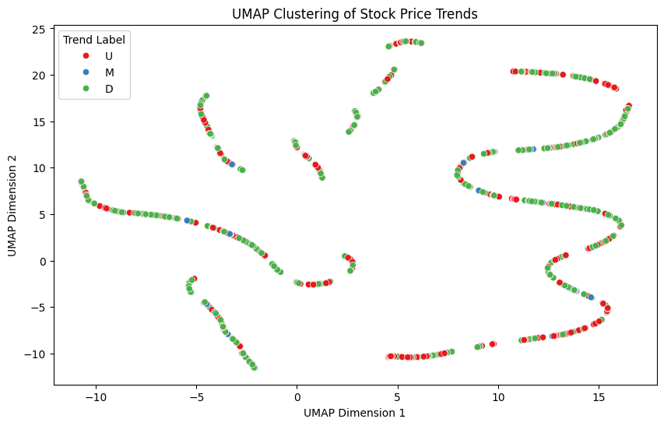
Trading Strategy and Back Testing
Labeling Based on Adjusted Close Price
Upward Trend (U) : when the future price increases by more than 0.5%.
Neutral Trend(M) : when the future price change is within ±0.5%
Downward Trend (D) : when the future price decreases by more than 0.5%.
Title

Slide 13
Trading Strategy and Back Testing
Rolling Window Table (Simplified Version)
Time frame reflects the stock trend indicator based on the model predictions (U for upward, M for neutral, and D for downward).
Time Frame | Indicator | Buy | Sell
1 | U | Buy (all) and hold stock
2 | D |  | Sell all stock and hold cash
3 | U | Buy (all) and hold stock
4 | D |  | Hold the cash
5 | U | Hold the stock
Title

Slide 14
Method
Methods
Principal Component Analysis (PCA):
Applied PCA to reduce data dimensions to 2 principal components for improved computational efficiency and visual interpretation.
Preserved maximum variance within the data to ensure key features are retained while reducing redundancy.
Models
Logistic Regression(baseline): Simple and interpretable
Random Forest: Robust for high-dimensional data
XGBoost: Powerful boosting algorithm, refines predictions by correcting errors from prior iterations

Slide 15
Result
Accuracy of Models
Logistic Regression: 38.11%
Random Forest: 56.12%
XGBoost: 54.97%
LightGBM : 52.89%
KNN : 56.58%
SVM : 51.73%
Data-Driven Workflow for Predicting Stock Trends in Dating App Companies

Slide 16
Conclusion
The backtesting results show limited accuracy, with the highest-performing models (e.g., KNN, Random Forest) achieving just over 55%，reflecting the challenges of forecasting volatile stock trends
Strategy evaluation suggests potential for improvement, particularly in adapting to market fluctuations
Key areas for future improvement:
i) Refining feature engineering to capture more nuanced patterns
ii) Expanding the dataset to include external factors,
such as macroeconomic indicators, to improve predictive power
Data-Driven Workflow for Predicting Stock Trends in Dating App Companies

